Slide 1
PI CONTROLLER

Slide 2
PI Controller
PI controller stands for propotional integral controller.
• P-I controller is mainly used to eliminate the steady state error resulting from P controller.
• This controller is mostly used in areas where speed of the system is not an issue.
• it is a combination of proportional and an integral controller the output (also called the actuating signal) is equal to the summation of proportional and integral of the error signal.

Slide 3
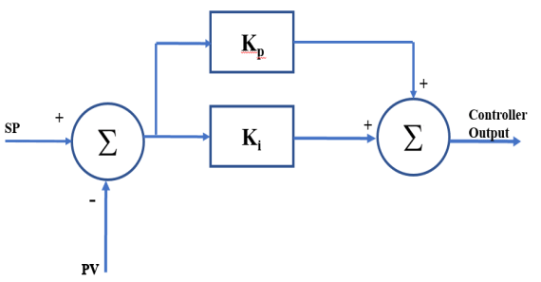
PI Controller
A proportional and integral controller output is directly proportional to the summation of proportional of error and integration of the error signal.
Where, Ki and kp proportional constant and integral constant respectively.

Slide 4
PI Controller
Advantages
Easy to implement
Minimizes fluctuations
Has high loop gain
Disadvantages
No fine controlling
Presence of offset error
Damping ratio is reduced which leads to increase in overshoot

